Slide 1
Website security – through exploiting vulnerabilities
Special project
This is my special project for the ambassador module
I have created a website with deliberate vulnerabilities
There are four tasks to complete
You cannot open the folder called “restricted” and you cannot use inspect element.
Please complete the “pre-lesson quiz”

Slide 2
Task One – Endpoints
In web development, endpoints are specific URLs where a client (such as a browser or mobile app) interacts with a server to access resources or perform actions.
Structure of an Endpoint typically includes:
Base URL – root address of the API (e.g., https://api.example.com/)
Path – identifies the resource or action (e.g., /users)
Query Parameters – refine/filter results (e.g., ?page=2)
These can be a security risk as without proper authorisation levels, users can manually change their URL to access restricted resources.
Try to access the ‘stats’ page on the batwest website.

Slide 3
Reveal answer?

Slide 4
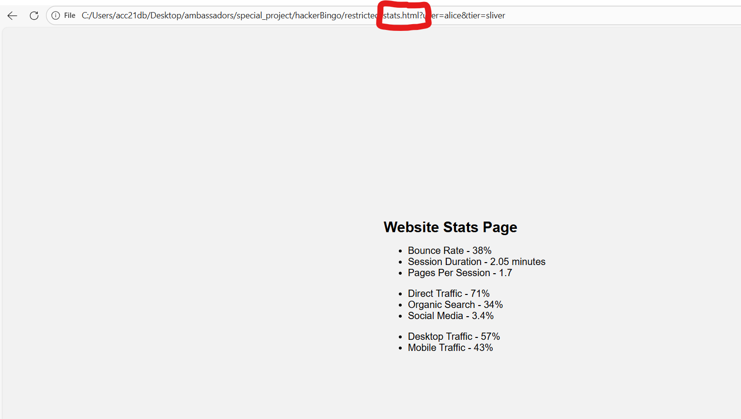

Slide 5
Task Two – URL Parameters (Query parameters)
URL parameters are extra pieces of information added to the end of a URL that tell a website how to customize the content, filter results, or track browsing sessions.
URL parameters appear after a question mark (?) and include key-value pairs that are separated by one or more ampersands (&).
Just like Endpoints they can be manipulated to access hidden content.
Try to access the batwest account that belongs to ‘charlie’.
Try to access the hidden batwest investor info.

Slide 6
Reveal answer?

Slide 7
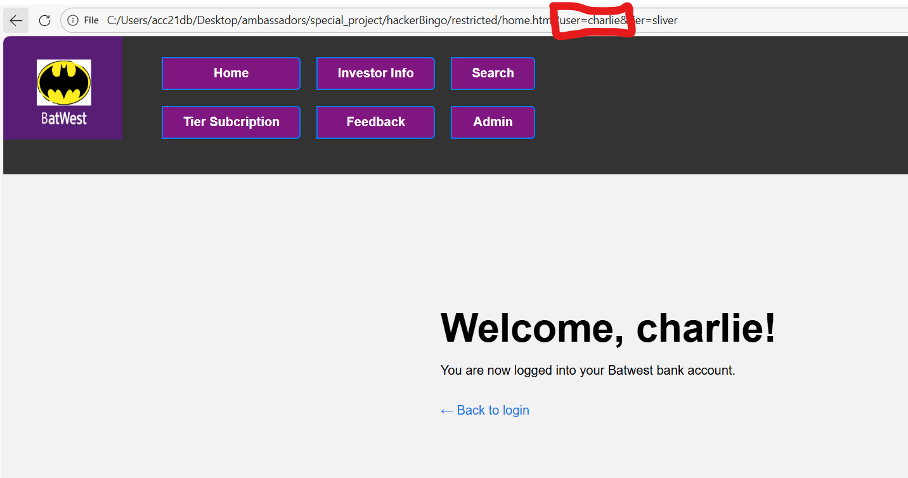
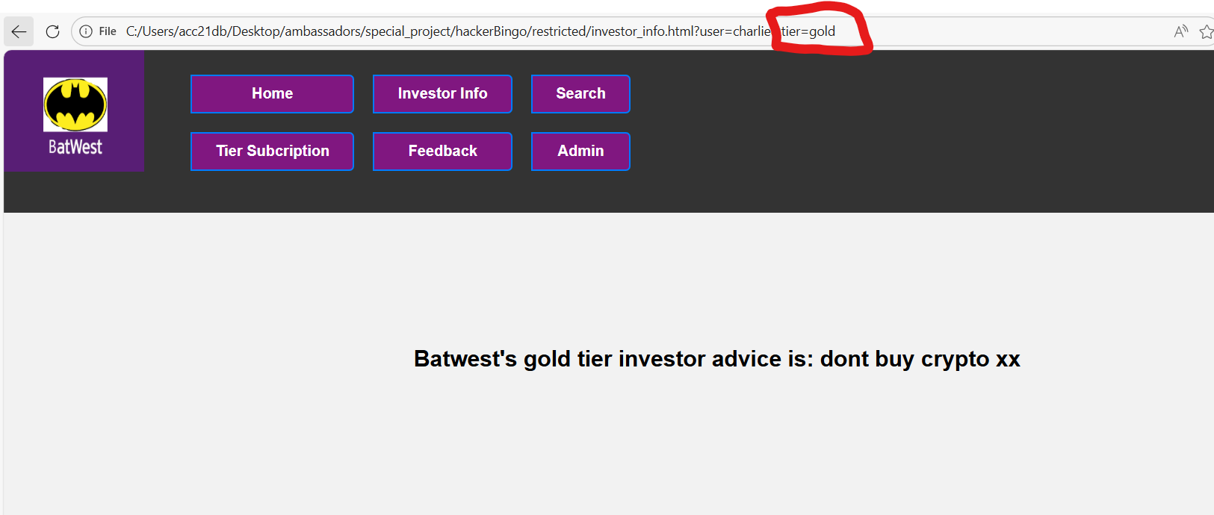

Slide 8
Task Three – Form manipulation
Forms will always be a vulnerability as they involve sending data from the user to the server.
Form can be secured using input validation, input sanitation.
Input validation – checks the input against a certain criteria before sending it to the server (blacklists / whitelists).
Input sanitation – remove prohibited characters / strings from the input before sending it to the sever.
A form manipulation attack involves finding a way past the safeguards to get data to the server it is unable to processes.
Try to rank the batwest services more than 10 out of 10
Try to cause a 500 internal sever error (hint – search page)

Slide 9
Reveal answer?

Slide 10
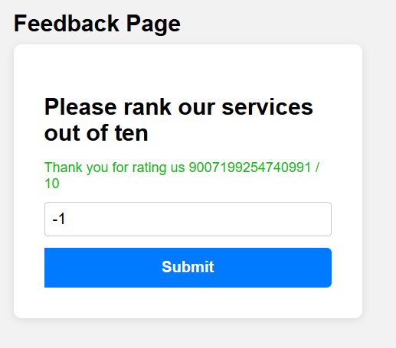
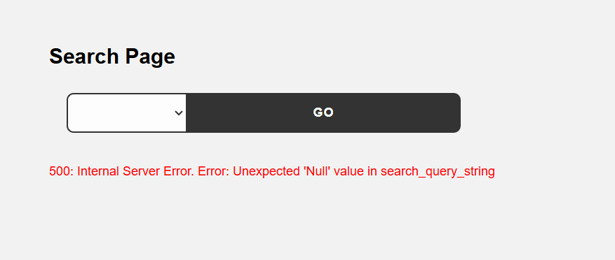

Slide 11
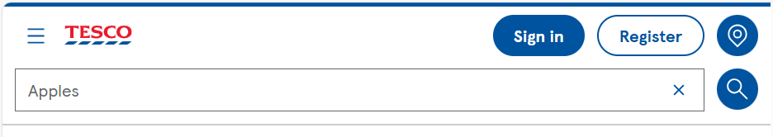
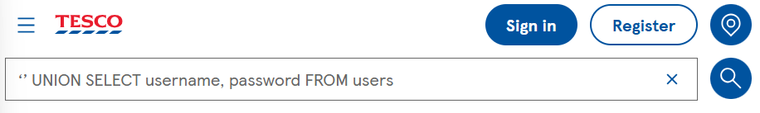
Task Four – SQL Injection
This is a more advanced type of form manipulation.
SQL Injection is a web security vulnerability that occurs when an application incorporates untrusted user input directly into SQL queries without proper validation or parameterisation.
Validation – checking the user input
Parameterisation – ensures that user-provided values are treated strictly as data, not executable SQL code.
Example – search bar
Backend SQL: SELECT name, description FROM products WHERE name = ‘Apples’;
The final command sent to the database becomes:
SELECT name, description FROM products WHERE name = ‘’ UNION SELECT username, password FROM users;

Slide 12
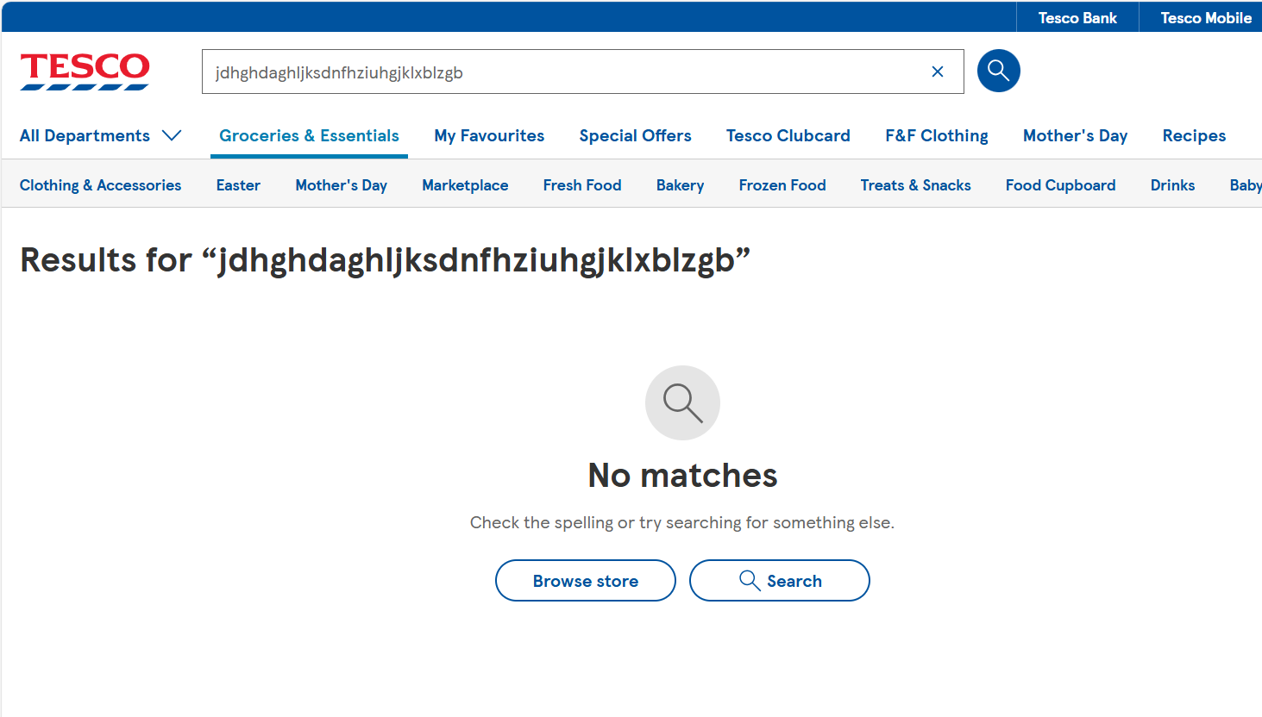
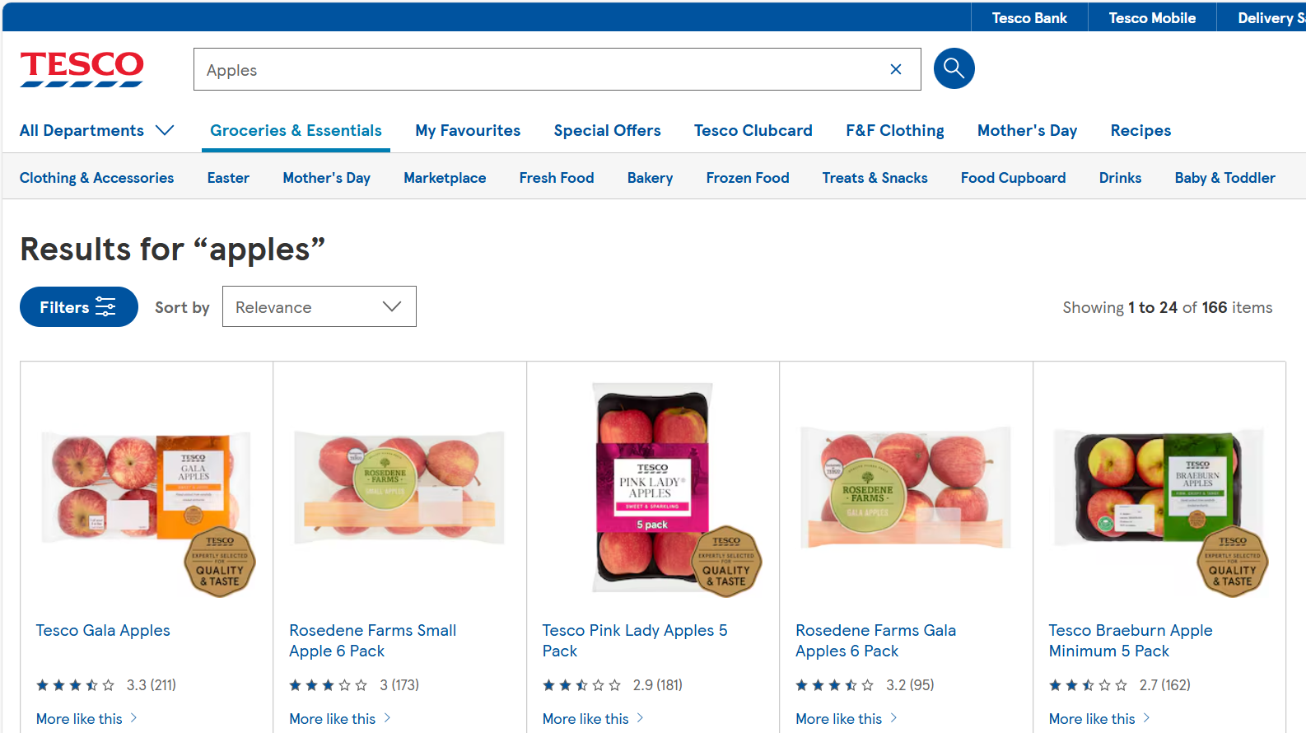
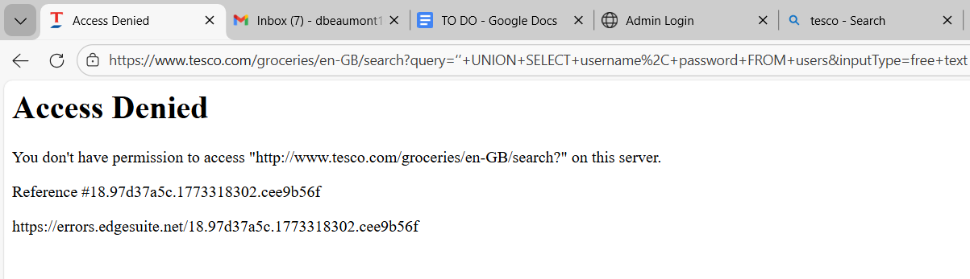
Query results
Surprisingly, no elegant handling of this error.
Which means this injection broke at least one layer of security.
289.36 million visits daily

Slide 13
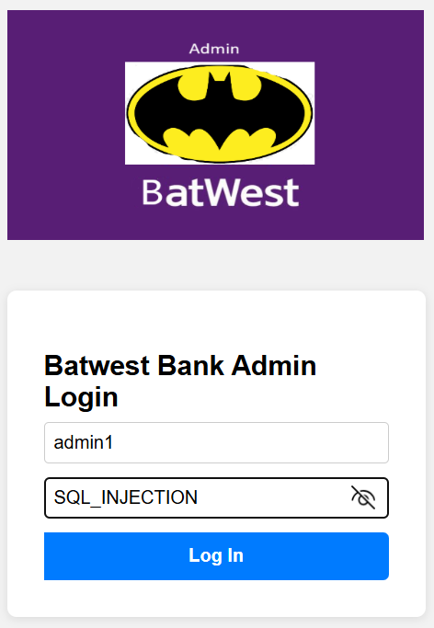
Task Four – SQL Injection (Cont)
SELECT * FROM users WHERE username = ‘admin1' AND password = ‘correctPassword123’;
Your injection will be appended to the query at this point:
SELECT * FROM users WHERE email = ‘admin1' AND password = ‘SQL_INJECTION
Can you find a way to make “ AND password = ‘User-input’ “ evaluate to true.
Try to break the query down into sections.
“Select where”
Condition 1
AND
Condition 2
Try to login as admin1
(Hint) – try thinking about extending condition 2 to include more Boolean logic

Slide 14
Reveal answer?

Slide 15
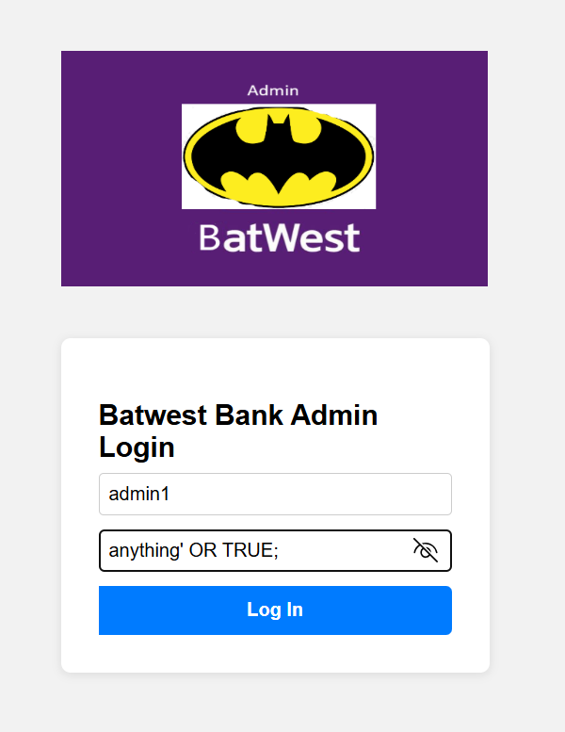
Close the string,
Extend the Boolean logic

Slide 16
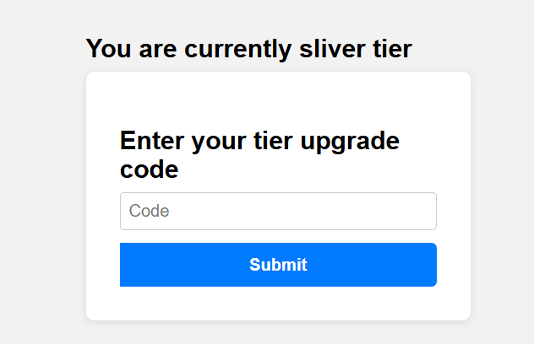
Task Four – SQL Injection, final task
Backend: UPDATE users SET tier = ‘Gold’ WHERE upgrade-code = ‘[USER_INPUT]’;
Using the form from the Tier page, try to delete the table called ‘users’
(Hint) – the SQL command to delete a table is ‘DROP TABLE’
(Hint) - For this injection, you need to execute your injection as a separate query, rather than appending to an existing query – use a semi colon to do this
Query 1
;
Query 2

Slide 17
Reveal answer?

Slide 18
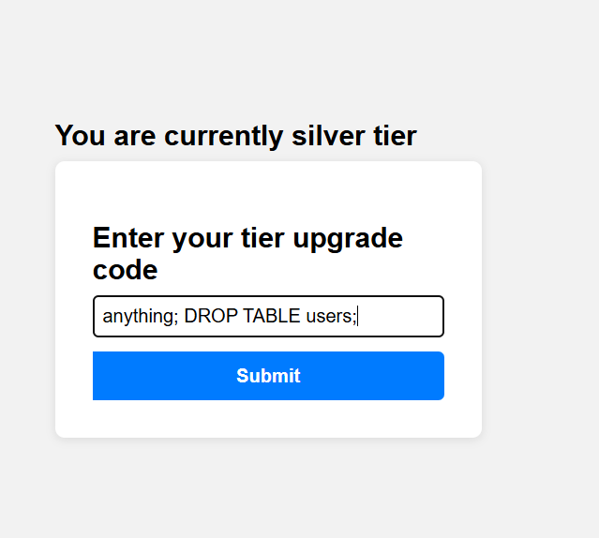
Semi colon completes the first intended query,
Can you then inject your own

Slide 19
Thanks for listening
Please complete the post-lesson quiz

